Slide 1
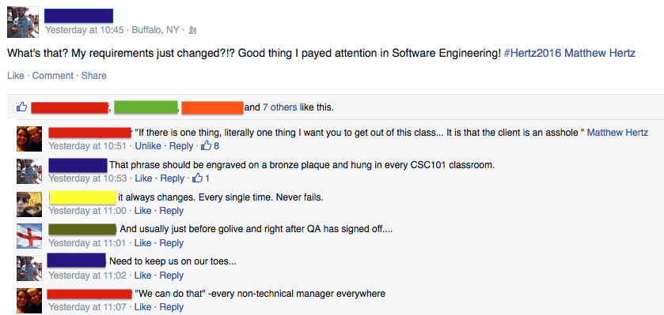
Lecture 5: requirements –or– You Want Me to Do What?
CSE 442 – Software Engineering

Slide 2
Meetings Started Today
Meet with TA in Baldy 19 at time you selected
Same time, same TA, (same place?) for all but grading
TA's role like that of a manager helping you learn
Help keep members on track & sharing work evenly
Serves as outside helping you improve communication
Focus team on process, rather than just development
Know everyone can hack; meetings not technical
Managers already know skills; rarely review your code
Cannot skip meetings, plus goal is to improve grades

Slide 3
Meetings Started Today
Meetings this week
Review and develop user stories
Generate tasks from user stories
Update scrum board with stories/tasks
Assign tasks to team members
Work 8 hours before next meeting
If your task is completed before 8 hours, create another one
Meetings for the rest of the semester
Each team member shows their progress from the last meeting
Assign tasks for the next meeting

Slide 4
Sprint Grading
Stories are mentioned often in the rubric
Review the rubric to know exactly what we’re looking for during grading
Refer to the slides for stories/task
Ask questions if you have them
“We didn’t know we had to do that” is not an excuse during your sprint demos

Slide 5
Requirements Key #1
Capture features needed to solve problem NOT features wanted by users

Slide 6
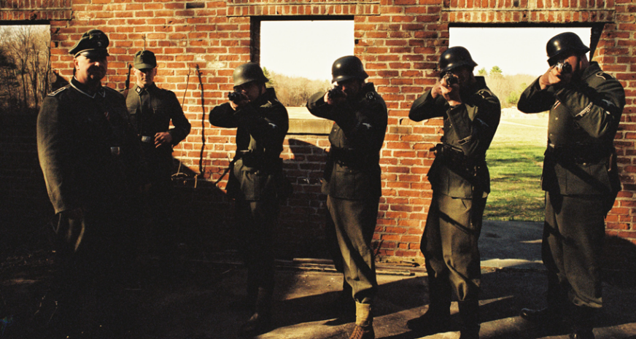
Why Do They Change?
Included contradictory or ambiguous requirements
Did not identify clients’ needs within list of wants
Requirements not understood by designers & coders
Client changes their mind later on in the process

Slide 7
Answer is Key to Course
Communication

Slide 8
Requirement Keys
Document what is required: Be specific on needs
Omit unnecessary details: Focus on substance not style
State what “success” is like: Write acceptance tests now
Notes:
Need to keep customer from changing mind
- Be certain you know what they are saying
- Be certain they know what they are saying
- Defer decisions as long as there is other work to do

Slide 9
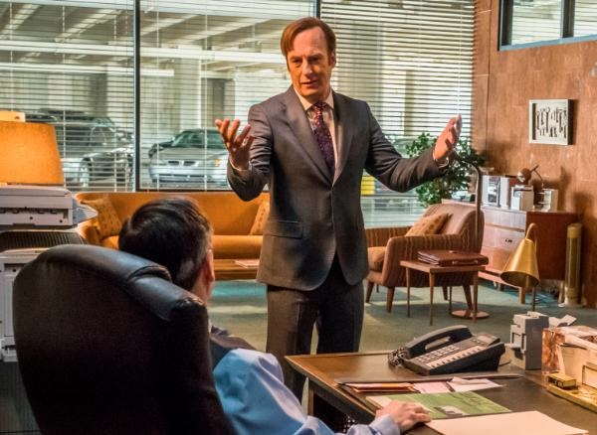
Why Requirements are Hard
All of your requirements must be meaningful to
Client
Designers
Developers
Users
Legal

Slide 10
How To Do This?
People ♥ stories Use stories to document
Understood by everyone; detailed, but not technical
Describes system details from user’s perspective
Cause-and-effect documented with needed details
Can provide insight into requirement’s importance
Automatically testable; story states effects of actions

Slide 11
Too Much vs. Too Little
Limit stories to highlight only required details
What occurs & why it happens are important to know
Clients, developers, & legal must agree on these details
How it happens unimportant: nobody cares (& will change)
Cannot just settle; must keep asking questions
“But what if ____” finds errors system must handle
Assume worst & ask “What problems could occur?”
“Is this really needed?” avoids documenting wants

Slide 12
User Stories to the Rescue
Lightweight approach for capturing requirements
Story documents single system interaction by user
Details will change so does not waste time on them
Needs fluctuate, so requirements readable by client
Explains why requirement needed to allow prioritization

Slide 13
User Stories to the Rescue
Lightweight approach for capturing requirements
Story documents single system interaction by user
Details will change so does not waste time on them
Needs fluctuate, so requirements readable by client
Explains why requirement needed to allow prioritization
When change expected, can better use resources
Cheap to create since user story often single sentence
May never be implemented, so eschews most details
Keeps focus on conversation rather than processes
Waterfalls need not apply, common in iterative models

Slide 14
User Story Basics
Short statement of customer values and wants
User’s view of feature described often in first person
For each feature, explains how & why user acts
Story should be testable: successful results shown
Provides enough detail to create further client dialog
Each story often a sentence, rarely more than two

Slide 15
User Story Basics
Short statement of customer values and wants
User’s view of feature described often in first person
For each feature, explains how & why user acts
Story should be testable: successful results shown
Provides enough detail to create further client dialog
Each story often a sentence, rarely more than two
“The gambler comes up and places his bet.”

Slide 16
User Story Basics
Short statement of customer values and wants
User’s view of feature described often in first person
For each feature, explains how & why user acts
Story should be testable: successful results shown
Provides enough detail to create further client dialog
Each story often a sentence, rarely more than two
“The gambler comes up and places his bet.”

Slide 17
User Story Basics
Short statement of customer values and wants
User’s view of feature described often in first person
For each feature, explains how & why user acts
Story should be testable: successful results shown
Provides enough detail to create further client dialog
Each story often a sentence, rarely more than two
“As a gambler, I place my bet.”

Slide 18
User Story Role
Written from user’s perspective: Document user's view;

Slide 19
User Story Role
Written from user’s perspective: Document user's view; including who they are (which is never user)*
Notes:
* Unless you are writing program for people actively engaging in illicit substance abuse

Slide 20
User Story Basics
Short statement of customer values and wants
User’s view of feature described often in first person
For each feature, explains how & why user acts
Story should be testable: successful results shown
Provides enough detail to create further client dialog
Each story often a sentence, rarely more than two
“As a gambler, I place my bet.”

Slide 21
User Story Basics
Short statement of customer values and wants
User’s view of feature described often in first person
For each feature, explains how & why user acts
Story should be testable: successful results shown
Provides enough detail to create further client dialog
Each story often a sentence, rarely more than two
“As a gambler, I want to place my bet so I can play blackjack.”

Slide 22
User Story Action
Actions story’s user will do to achieve their goal

Slide 23
User Story Basics
Short statement of customer values and wants
User’s view of feature described often in first person
For each feature, explains how & why user acts
Story should be testable: how do we know it works?
Provides enough detail to create further client dialog
Each story often a sentence, rarely more than two
“As a gambler, I want to place my bet so I get dealt a hand.”

Slide 24
User Story Basics
Short statement of customer values and wants
User’s view of feature described often in first person
For each feature, explains how & why user acts
Story should be testable: successful results shown
Provides enough detail to create further client dialog
Each story often a sentence, rarely more than two
“As a gambler, I want to place my bet so I get dealt a hand.”

Slide 25
User Story Reward
Why is system used to accomplish goal & how will user know it worked?

Slide 26
Be Wary of Details
“As a gambler, I want to place my bet so I get dealt a hand.”
How is a bet is placed?
Possibilities include credit cards, chips, implantable IDs
This could change, but does not change user's story
Each story is part of a dialog may not be fully formed
Negotiations on details occur when stories developed
Many ideas never get coded, this avoids losing time

Slide 27
Story Documents 1 Feature
Story written for each feature program could include
Story centers on a story; implementation not discussed
Write what the role experiences; omit all other details
“As a player happy with my cards, I want to stand with hand so I can see if I won.”
"As a casino owner I want to increase my profits so betting is not in cash."

Slide 28
Useful User Stories
Must deliver what client expects;

Slide 29
Useful User Stories
Must deliver what client expects;
Stories written for clients to understand

Slide 30
User Story Gotchas #2
Some features fixed; many details change
Only include needed features in story

Slide 31
User Story Gotchas #2
Some features fixed; many details change
Only include needed features in story

Slide 32
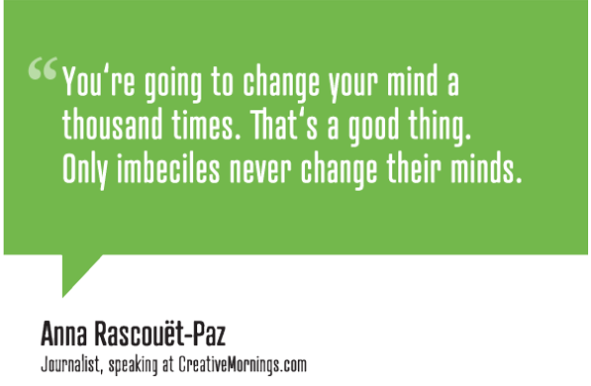
Why User Stories?

Slide 33
User Story Outline
“As a <role>, I want <action> so I <testable reward>.”
Most common template used for user stories
But these are stories, so templates not required/used
Lots of roles exist among the users of a system
Customer representative (or clients) present most ideas
Others may exist: big betters expect special treatment
Team brainstorm roles and see if stories might change
Bring ideas back to conversation: client has final say

Slide 34
User Story Outline
As a <role>, I want <action> so I <testable reward>.

Slide 35
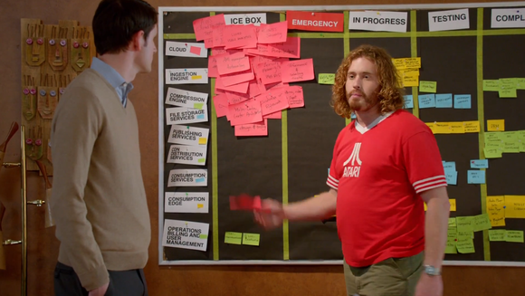
How Many Stories Needed?
User stories intended to be very, very cheap & easy
All potential ideas written up; many never implemented
Sprints begin when pick important stories from backlog
Stories will get “stale”; discard if too old (or not needed)
May end up circling around; no shame in recreating story

Slide 36

Knowing When Story “Done”
When story included in sprint, need acceptance tests
Used to check that story done & implemented correctly
Often step-by-step script of actions & correct outcomes
Uses non-technical language, since run by clients
At least 1 test, but okay to have multiple tests for 1 story

Slide 37
Making It Work
Once acceptance test(s) written, make tasks for story
Tasks are concrete steps needed to implement story
By creating tasks, team organizes work to be done
Each task stands alone, but some may “block” others
Created & used by developers; technical words fine here
Tasks added to scrum board showing work for sprint
Easy to avoid conflicts by marking task while completing
Update status as you go; scrum board shows what to do
Can also place commits in context – message links to task

Slide 38
Tools To Use
Project must be shared in group using a GitHub/BitBucket repo
Combines free space & excellent reliability
Scrum board support via ZenHub/etc
Direct connections supported, connects to GitHub repo
Does use full project budget ($0 -- accounts are free)
Many teams using Trello
It is up to your team to link your scrum board and stories with your repo
Should be simple to move between task on scrum board to branch/commits/pull requests/code associated with that task
Should be simple to find acceptance tests for each story

Slide 39
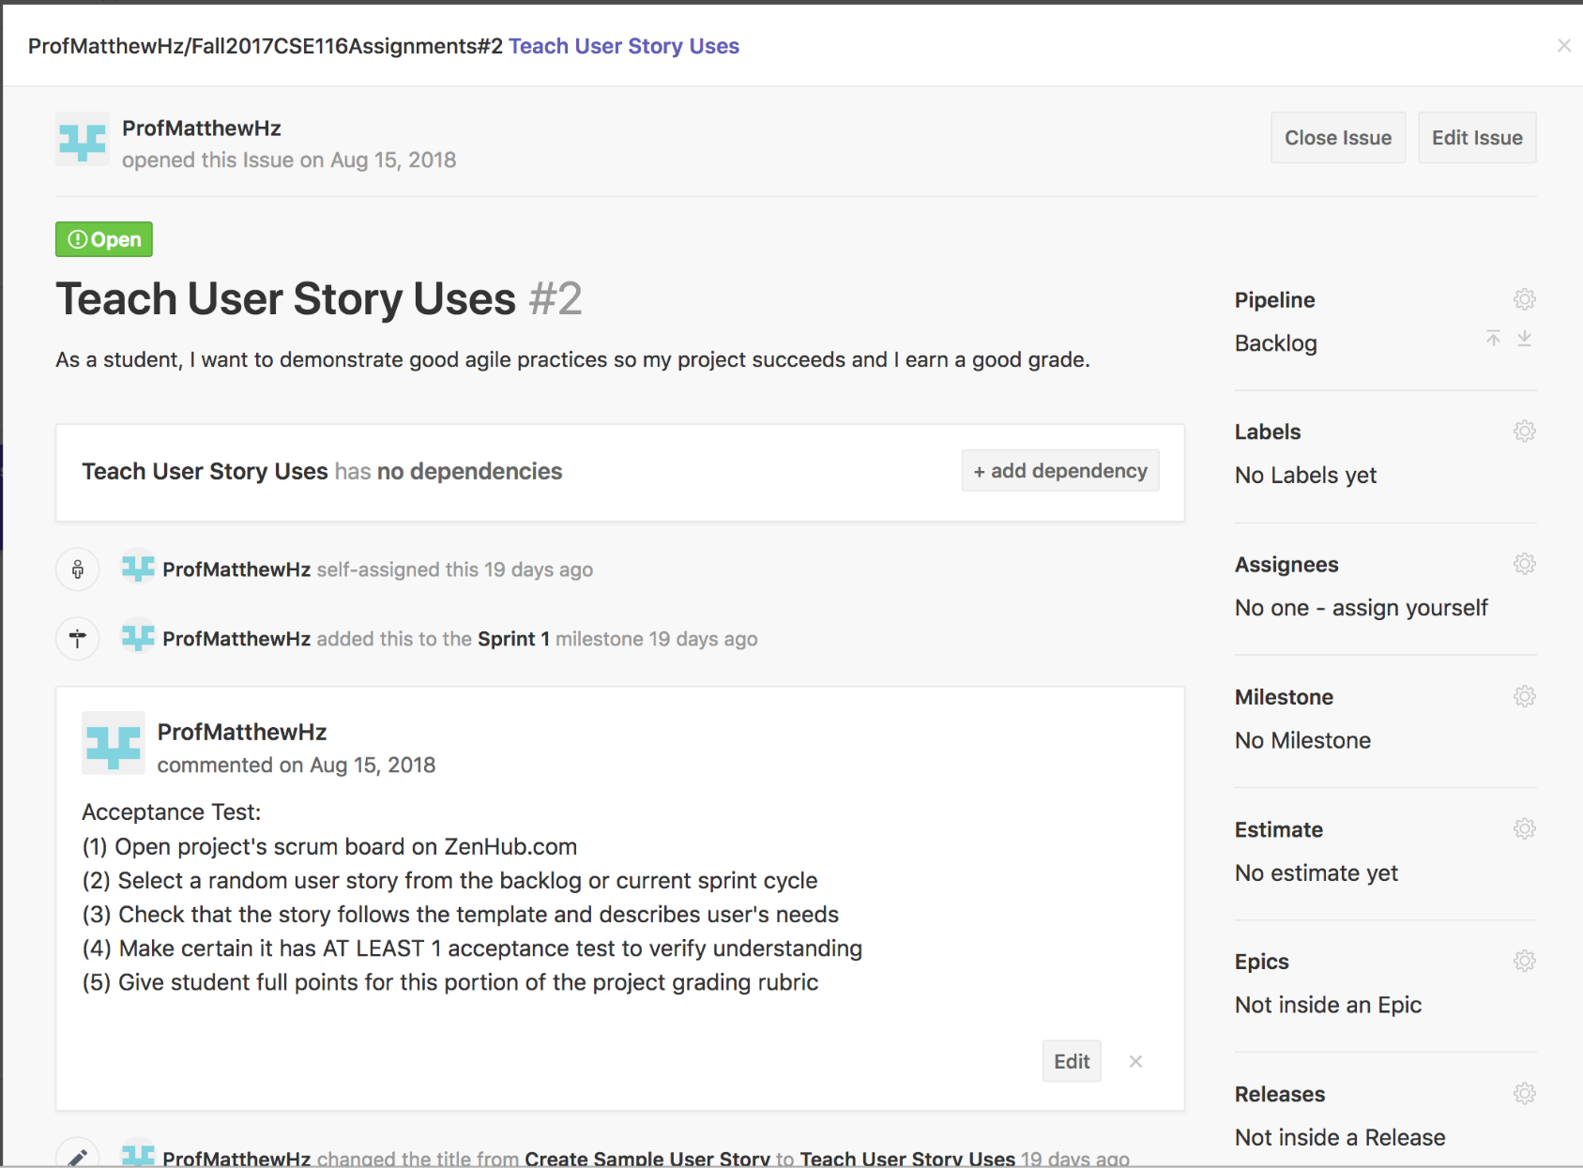
Example Story in ZenHub

Slide 40
Lecture 7: Stories, Tasks & Boards, oh My!
CSE 442 – Software Engineering

Slide 41
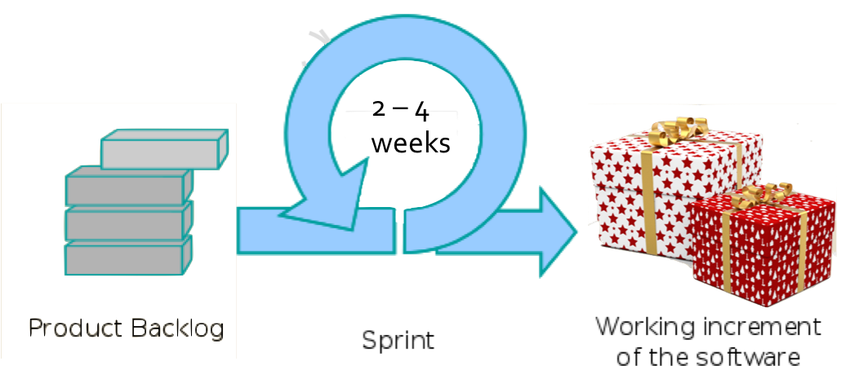
Scrum Development Overview
"User Stories"
Notes:
Picture of "Bow-boxes-celebration" was added to public domain by Pixabay.com. Original image is available at: https://www.pexels.com/photo/bow-boxes-celebration-gifts-260188/
Picture of "Scrum Process" by Lakeworks and used under a CC BY-SA 3.0 license. The original image is available at: https://commons.wikimedia.org/wiki/File:Scrum_process.svg

Slide 42
Language Still Imprecise
Problems still possible, even if all agree on story
Simple template leaves space for differences in meaning
Confirm understanding now to avoid issues later
Easiest approach is putting requirements through test(s)
Acceptance test(s) confirm story's meaning & needs
Tests document how user knows story complete
Provides confirmation as to what story is specifying
Confidence increases by describing correct outcome(s)

Slide 43
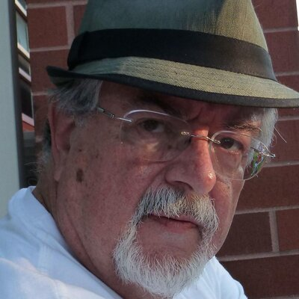
What Goes Into a User Story
User stories have three critical aspects. We can call these Card, Conversation, and Confirmation.
Ron Jeffries
Notes:
Picture used under the "Fair Use" exception to copyright law. The original image is from Ron Jeffries twitter feed: https://twitter.com/RonJeffries

Slide 44
What Goes Into a User Story
User stories have three critical aspects. We can call these Card, Conversation, and Confirmation.
User stories simple; Text should fit on index card
Ron Jeffries
Notes:
Picture used under the "Fair Use" exception to copyright law. The original image is from Ron Jeffries twitter feed: https://twitter.com/RonJeffries

Slide 45
What Goes Into a User Story
User stories have three critical aspects. We can call these Card, Conversation, and Confirmation.
Conversations key;
user stories just to record result
Ron Jeffries
Notes:
Picture used under the "Fair Use" exception to copyright law. The original image is from Ron Jeffries twitter feed: https://twitter.com/RonJeffries

Slide 46
What Goes Into a User Story
User stories have three critical aspects. We can call these Card, Conversation, and Confirmation.
Meaning matters
Acceptance tests required
to confirm understanding
Ron Jeffries
Notes:
Picture used under the "Fair Use" exception to copyright law. The original image is from Ron Jeffries twitter feed: https://twitter.com/RonJeffries

Slide 47
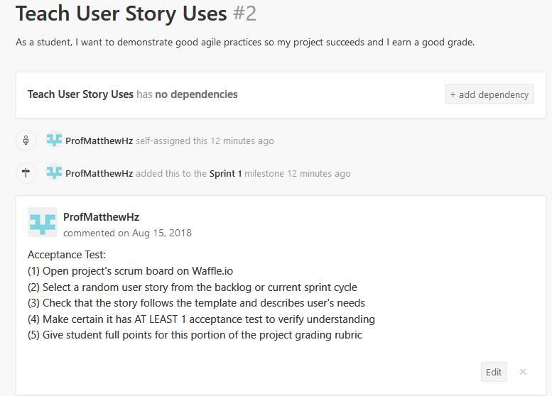
User Story in ZenHub

Slide 48
User Story in ZenHub
Card

Slide 49
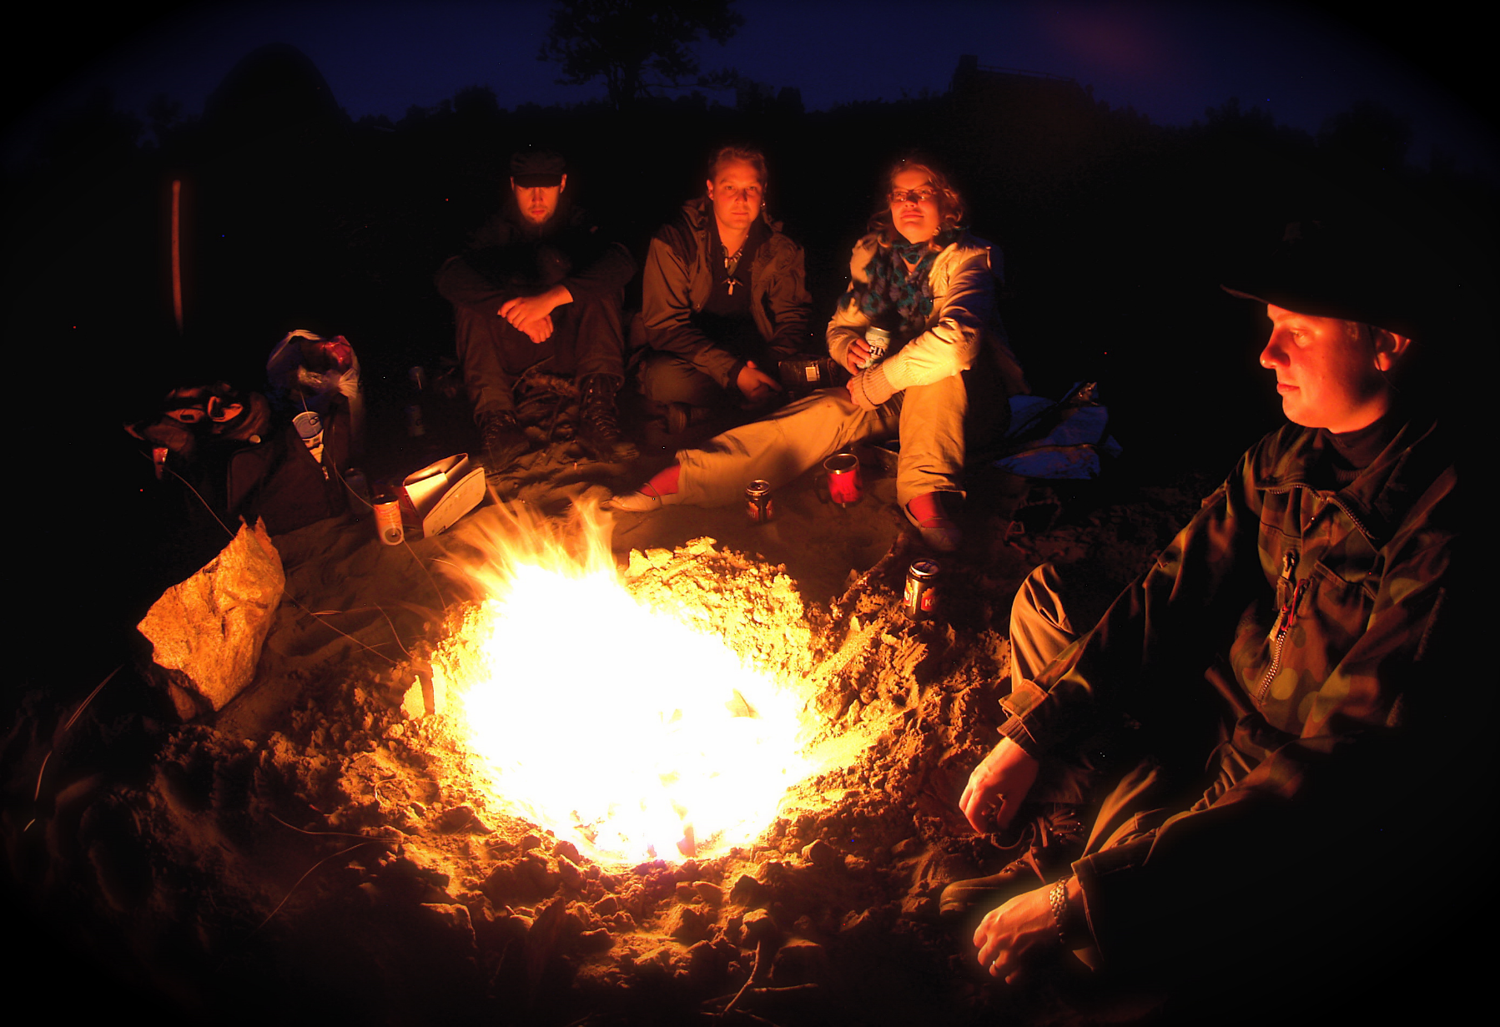
User Story in ZenHub (not)
Conversation
Notes:
Image of "Campfire on Kaamanen road" by Ville Miettinen and used under CC-BY-NC 2.0 license. Original image is available at: https://www.flickr.com/photos/wili/233621595

Slide 50
User Story in ZenHub
Confirmation

Slide 51
Sprint Planning
Every sprint begins with meeting planning sprint
Predictions "impossible”; only consider current sprint
Team starts by reviewing & revising backlog stories
Clarify meaning & write better tests with current info
Using team's input, product owner reprioritizes stories
Stories for current sprint chosen by entire team
Look for features that both easy & provide real value
Skip unclear or low priority stories, since deadlines tight

Slide 52
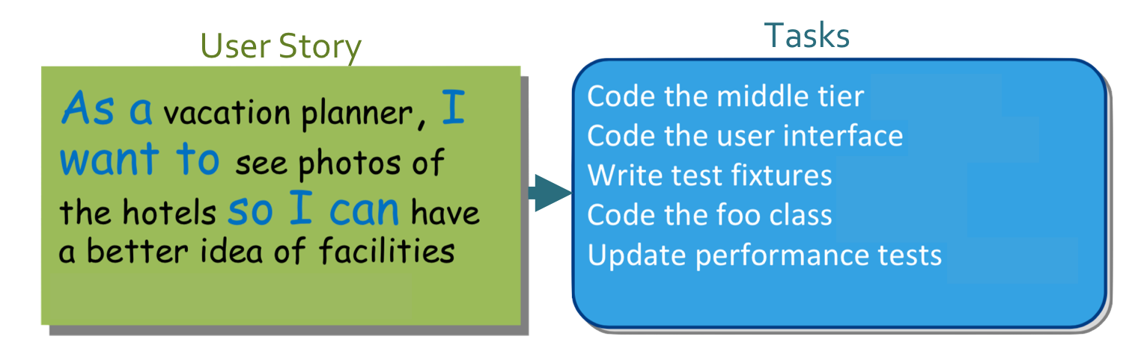
Stories Become Tasks
Team divides selected user stories into 1+ tasks
Each task is work item completed by one person(ish)
Tasks for development team: technical details important
High-level details only; implementation issues avoided

Slide 53
Task Time Estimation
In planning meeting, estimate each task's time
Have limited details; not enough for precise metrics
Instead, rely upon intuition & "wisdom of the crowds"
"Planning poker" process converges on task ideal times

Slide 54
Task Tests
Tasks also need tests to know when work complete
You know work correct, but increases others confidence
Proves bug not your fault when mistakes arise later on
Since using good practice, improves teams trust later
More options for task test(s) since tasks technical
For tasks about code, list unit tests created for task
Scripts showing how to see success can also be provided
Cannot prove success, but building confidence in result

Slide 55
Testing Key Concept
Write tests to guide development, simplify debugging & build confidence
Notes:
Cannot prove success using tests. So purpose cannot be correctness. Instead…

Slide 56
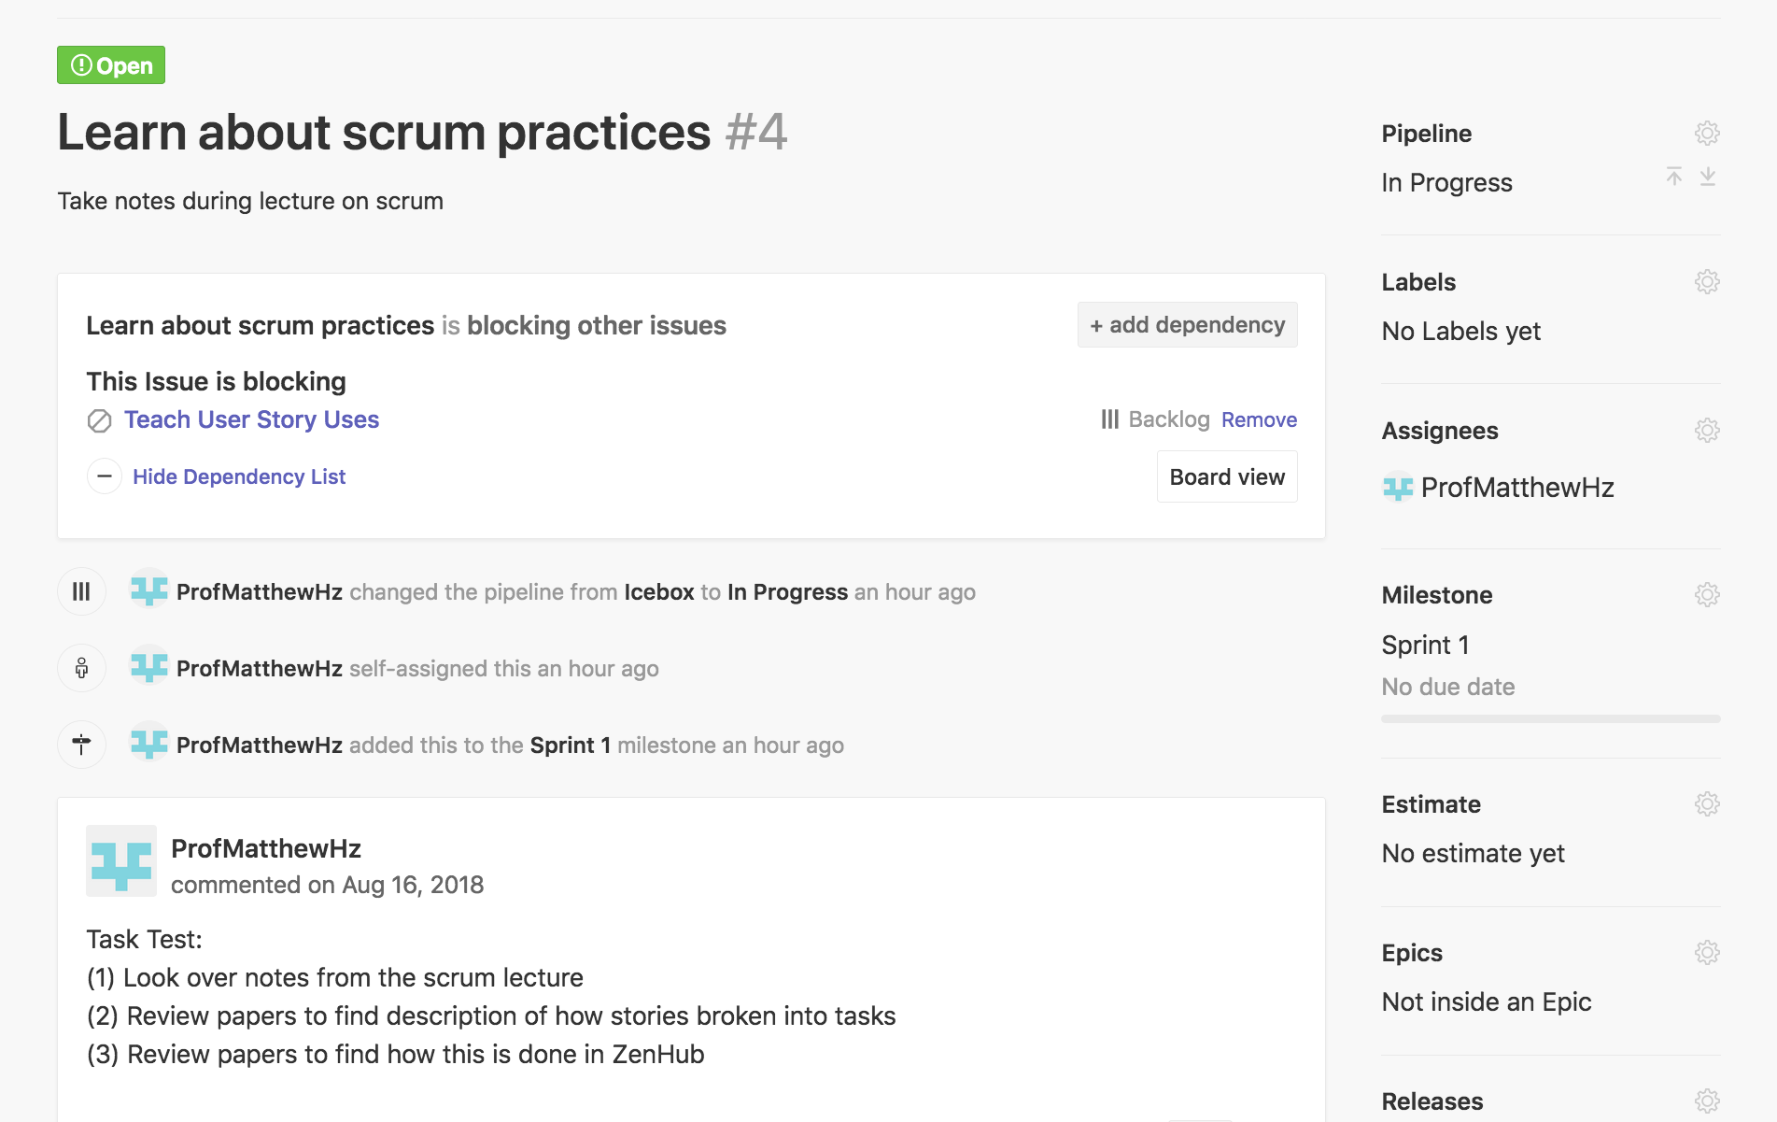
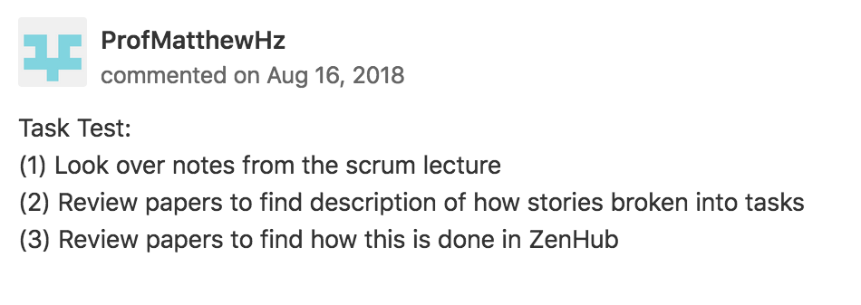
Task Tests

Slide 57
Mischief Managed
Should let others know once task completed
Other tasks may be blocked until know your task works
Stories near completion clarified & should be finished
Document your value so boss can see you being busy
Mark tasks "Closed" when finished & tested
Will also merge task branch back into story's branch
Can merge story branch to dev, if story now complete
Always more to do! Assign self to another task

Slide 58
Key Sprint Challenges
Need for management remains even with Scrum
Important to hold team accountable for sprint demands
Individuals accountable to team for doing their share
Keep focus on goals to allow selecting best tasks to do
Track work completion to allow sprint plan changes
Add more stories to sprint if more work needed
If too much remains, triage stories for postponement
Agility is the key; important to have quick reactions

Slide 59
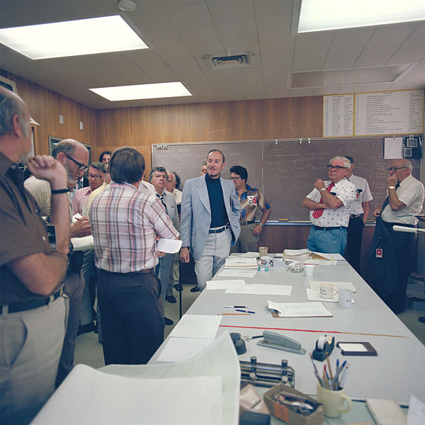
Daily Scrum/Standup Meeting
Workdays start with 15-minute meeting – always
Time limit very strictly enforced; keeps things quick
Once ended, smaller conversations follow-up issues
No chairs allowed; required standing keeps it brief
Notes:
Picture is a daily stand-up from NASA's Saturn Project in 1979. This is not a new idea.
Original image of "Pioneer Saturn- project manager daily stand up meeting" by NASA and, as government property, is in the public domain. Download available at: https://www.flickr.com/photos/nasacommons/4994063804/

Slide 60
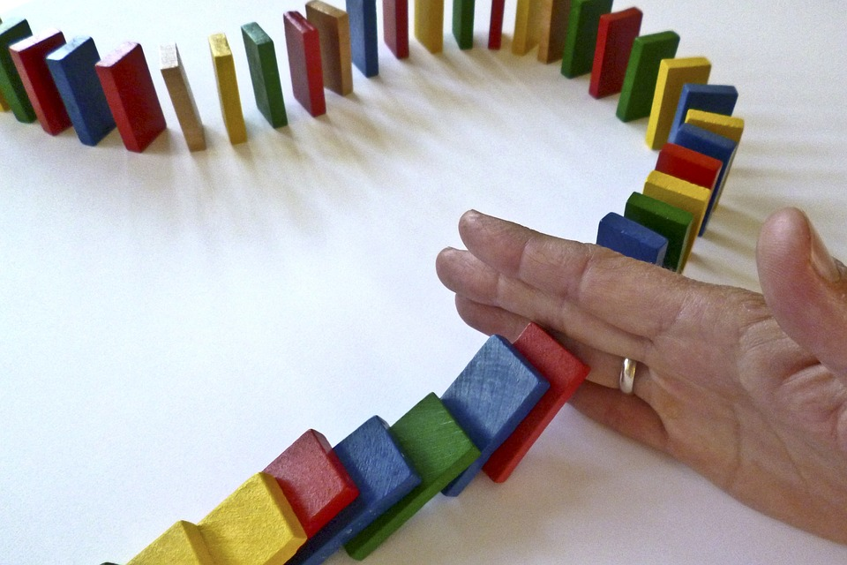
Daily Scrum
Point is accountability & not solving problems
Goal is avoiding meeting; defeats purpose if too long
All team members share status (except ScrumMaster)
Only sharing updates, wait for meeting end to comment
Notes:
"Dominoes stopped by hand" originally by CSchmidt-EC and donated to public domain. Original image is available at: https://pixabay.com/en/dominoes-domino-barricade-hand-1902622/

Slide 61
Standup Status Update
What you did yesterday
What you will do today
What, if anything, prevents progress

Slide 62
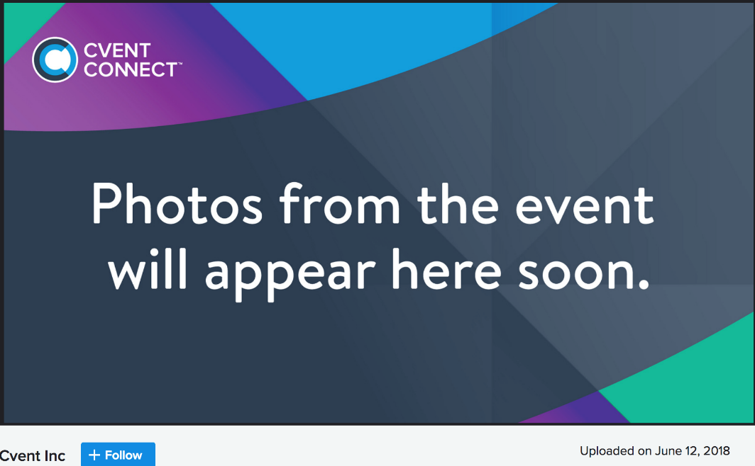
Daily Scrum Mistakes
Biggest mistake: tardy/skipping daily standup
Unfair to teammates – must guess at your progress
Teammates should assume slacking – accountability lost
Disrespectful to others – later time needed for questions
Rituals need repetition – longer meetings could occur

Slide 63
Daily Scrum Mistakes
Annoying mistake: grandstanding
Tracking sprint progress; critical to be honest and open
Focus on big picture; details unhelpful & waste time
Big mistake: lack of commitment
Planning still needed; public statements avoids laziness
Physical scrum board updated; keeps team updated
(ScrumMaster's job during meeting is to maintain board)
Keeps team accountable; avoids waiting for deadlines

Slide 64
Burndown Chart
With Scrum Board, burndown chart shows progress
X-axis shows days remaining until release/sprint end
Total expected hours remaining shown on Y-axis
Constant "velocity" ideal, want smooth drop with time
Reality rarely clean, but with practice gets much closer
Notes:
Image of "Agilo-Burndown-Chart" by Jeff Covey used under a CC BY-SA 2.0 license. Original image available at: https://www.flickr.com/photos/jeffcovey/3771680423

Slide 65
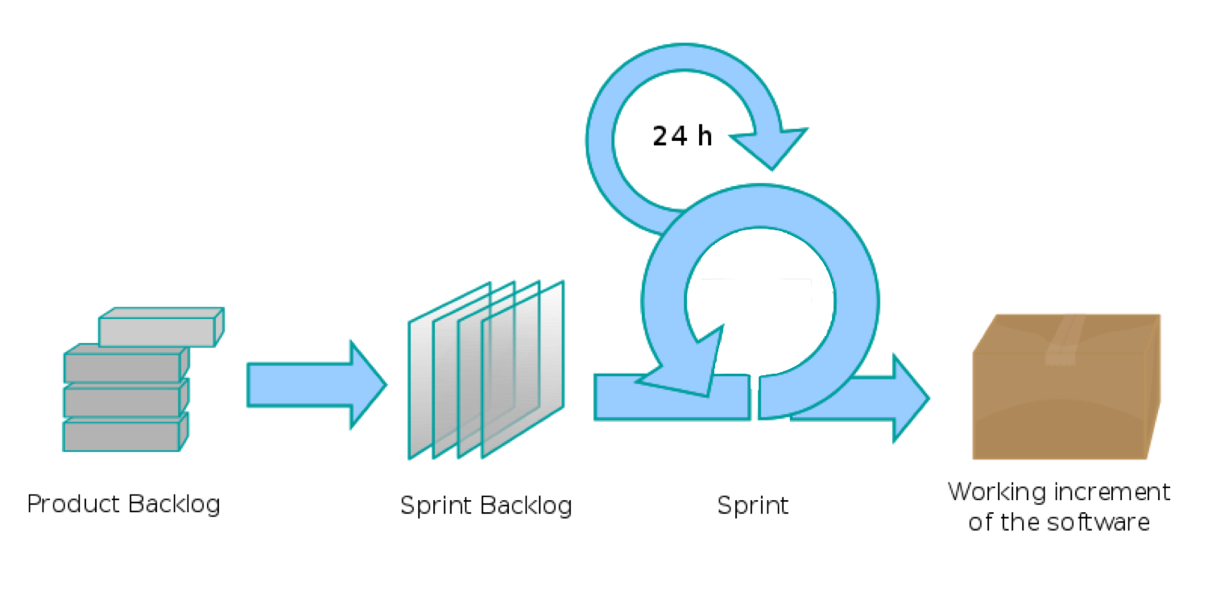
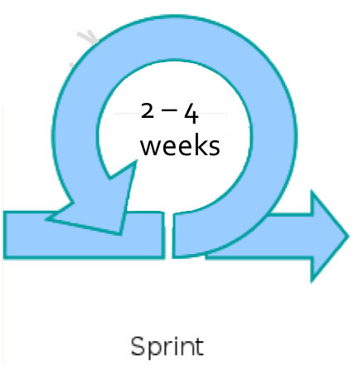


Sprint Overview
24 hrs
Planning Meeting
Stories selected & tasks created

Slide 66
Sprint Retrospective
Occurs after end-of-sprint presentation and release
Gives team chance to reflect on what happened in sprint
First focus on positives: what worked & why it worked
Things that sucked & how to improve discussed next
Meeting limited to 30 minutes; still agile process
Entire team participates; need all voices to do well
Everyone equal in meeting; democratic team, after all

